Slide 1
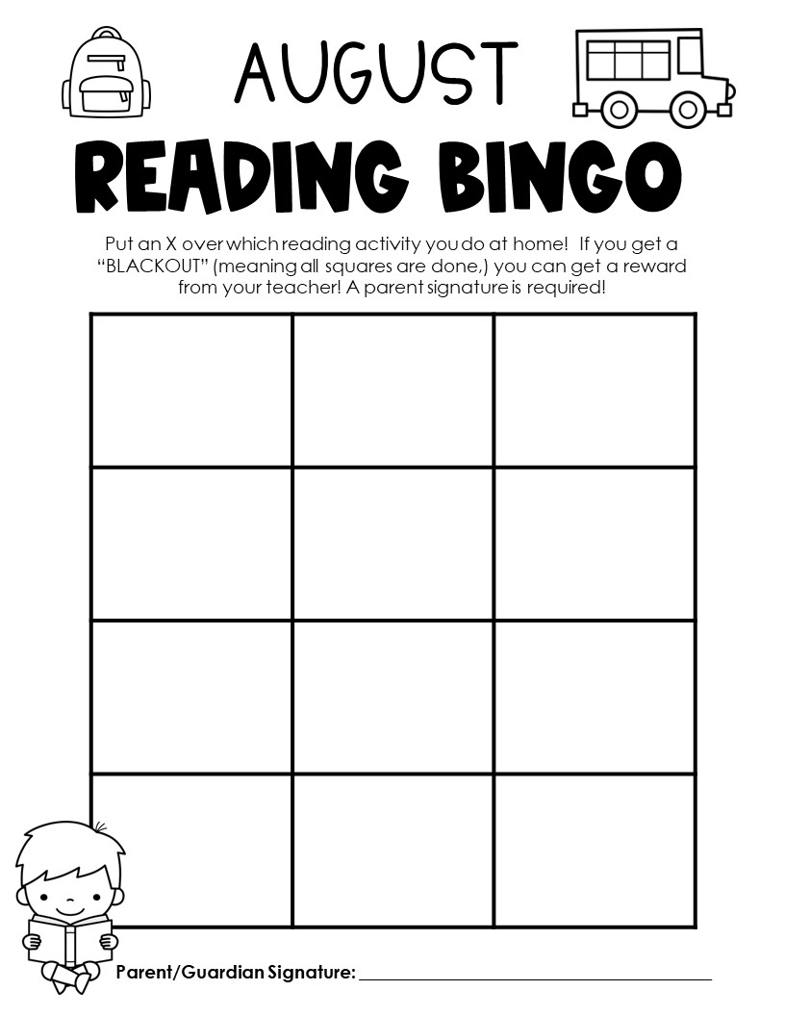
Read for 20 minutes
Read a fiction book
Read for 20 minutes
Read to a stuffed animal
Read a book that has animals
Read to a sibling or friend
Read a book in your favorite spot
Read a book that makes you laugh
Read out loud to an adult
Read for 20 minutes
Read a non-fiction book
Read for 20 minutes

Slide 2
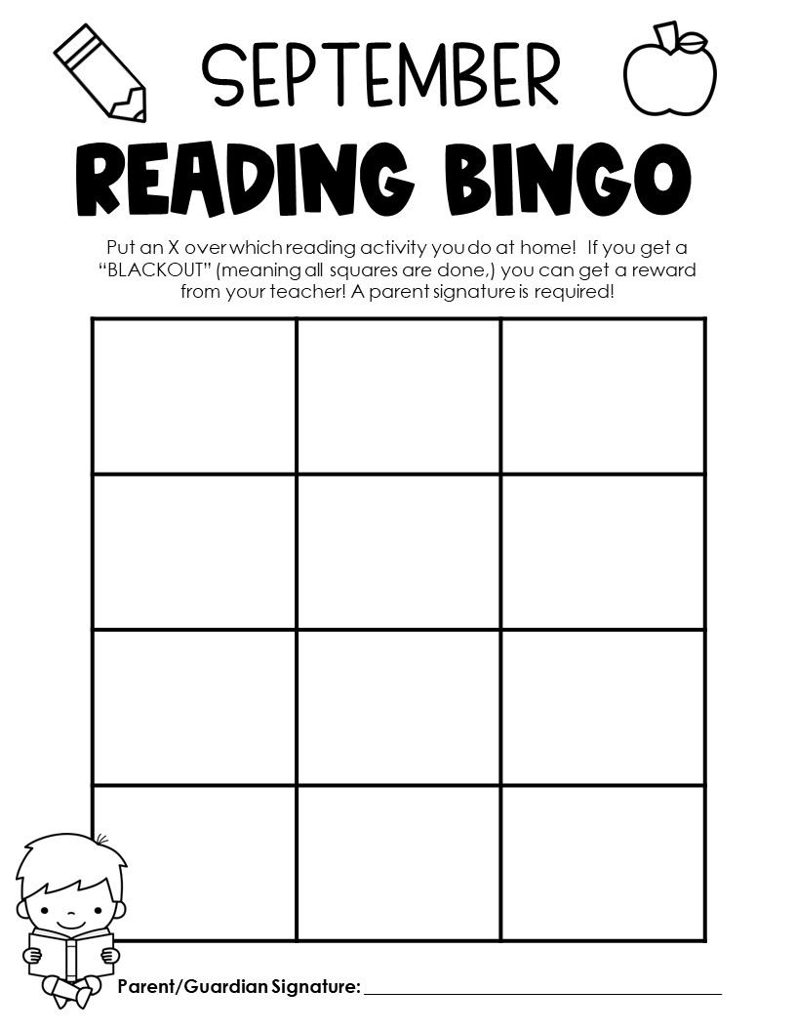
Read for 20 minutes
Read a fiction book
Read for 20 minutes
Read to a stuffed animal
Read outside
Read to a sibling or friend
Read a book in your favorite spot
Read a library book
Read out loud to an adult
Read for 20 minutes
Read a non-fiction book
Read for 20 minutes

Slide 3
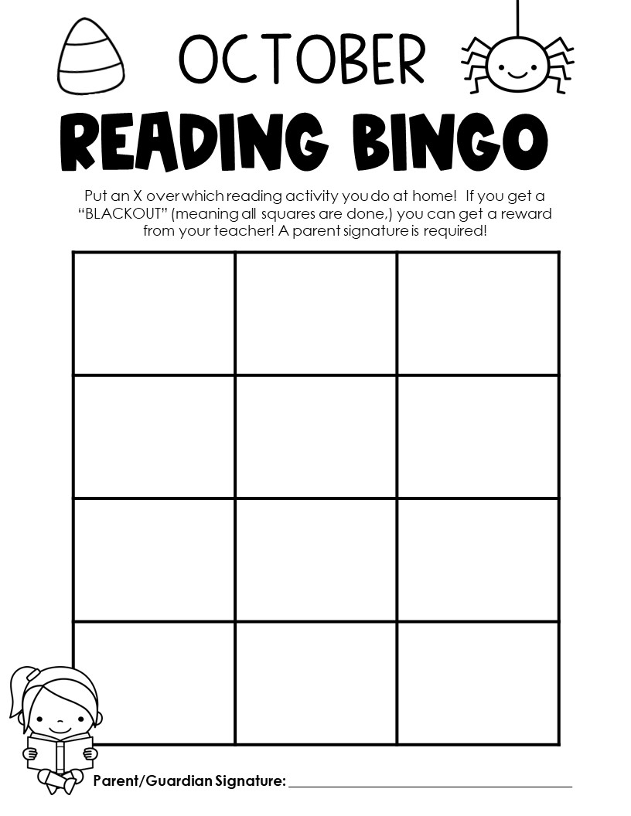
Read for 20 minutes
Read a fiction book
Read for 20 minutes
Read to a stuffed animal
Read a spooky story
Read to a sibling or friend
Read a book in your favorite spot
Read with a flashlight
Read out loud to an adult
Read for 20 minutes
Read a non-fiction book
Read for 20 minutes

Slide 4
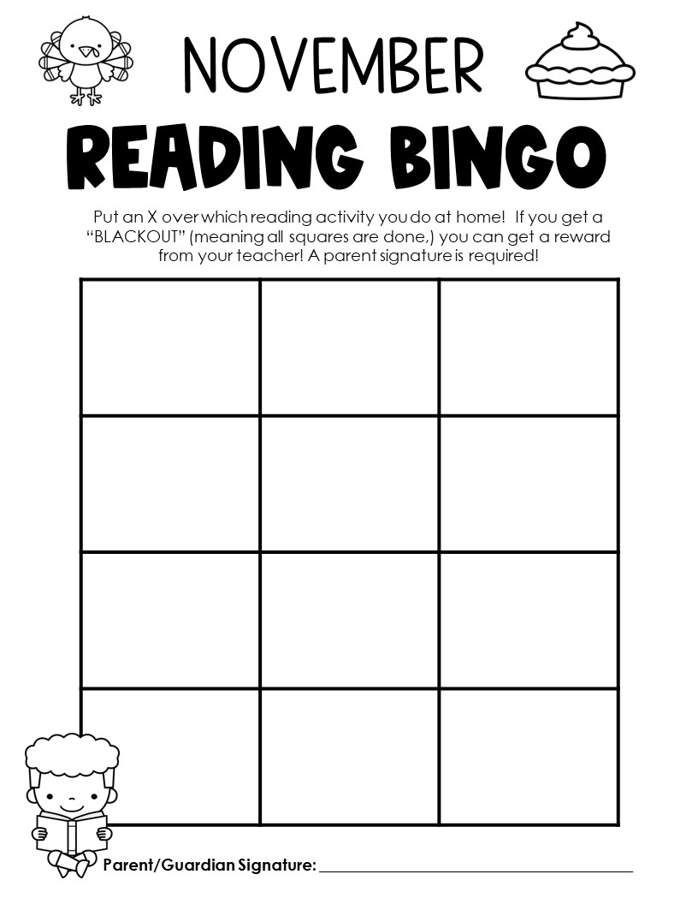
Read for 20 minutes
Read a fiction book
Read for 20 minutes
Read to a stuffed animal
Read a book in the car
Read to a sibling or friend
Read a book in your favorite spot
Read a book during Thanksgiving Break
Read out loud to an adult
Read for 20 minutes
Read a non-fiction book
Read for 20 minutes

Slide 5
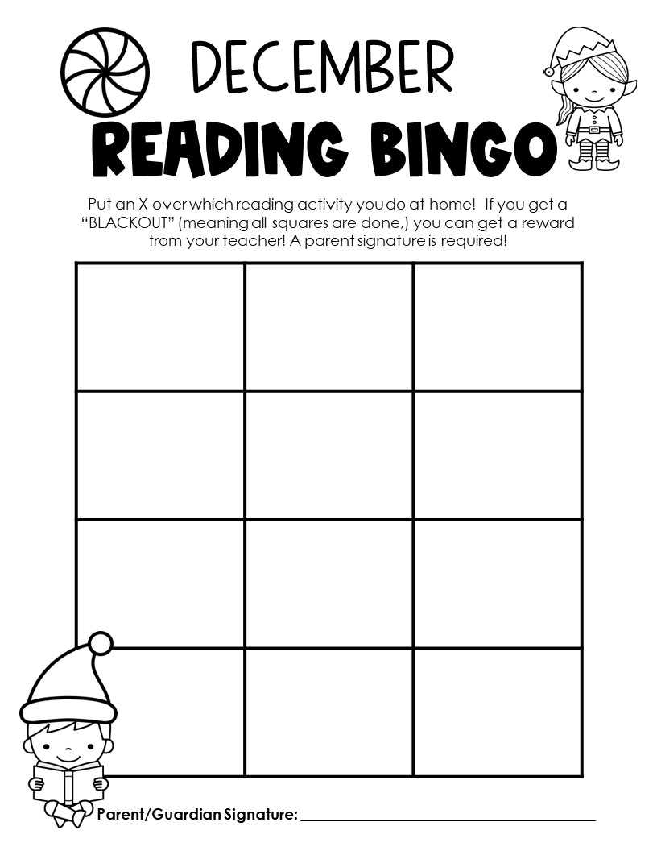
Read for 20 minutes
Read a fiction book
Read for 20 minutes
Read to a stuffed animal
Read a book about the Holidays
Read to a sibling or friend
Read a book in your favorite spot
Read a book during Winter Break
Read out loud to an adult
Read for 20 minutes
Read a non-fiction book
Read for 20 minutes

Slide 6
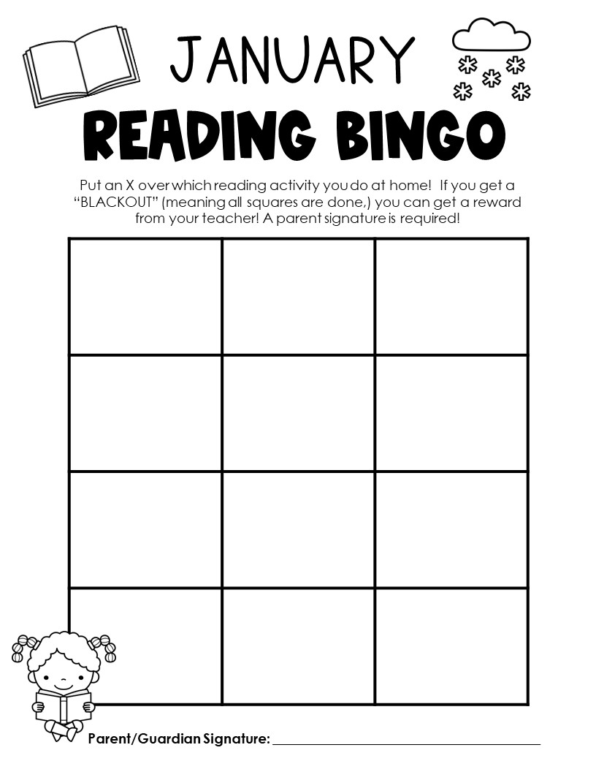
Read for 20 minutes
Read a fiction book
Read for 20 minutes
Read to a stuffed animal
Read a book while wearing pajamas
Read to a sibling or friend
Read a book in your favorite spot
Read a book under a cozy blanket
Read out loud to an adult
Read for 20 minutes
Read a non-fiction book
Read for 20 minutes

Slide 7
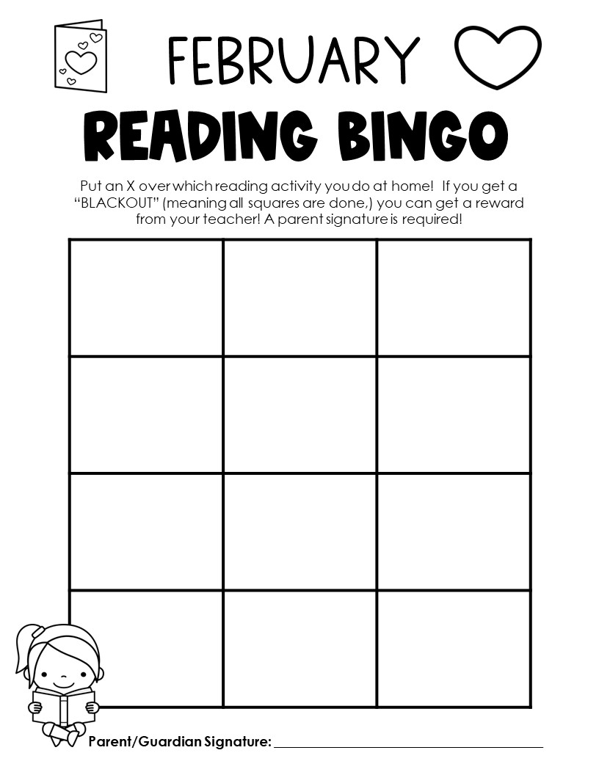
Read for 20 minutes
Read a fiction book
Read for 20 minutes
Read to a stuffed animal
Read a book you LOVE
Read to a sibling or friend
Read a book in your favorite spot
Read a book about kindness
Read out loud to an adult
Read for 20 minutes
Read a non-fiction book
Read for 20 minutes

Slide 8
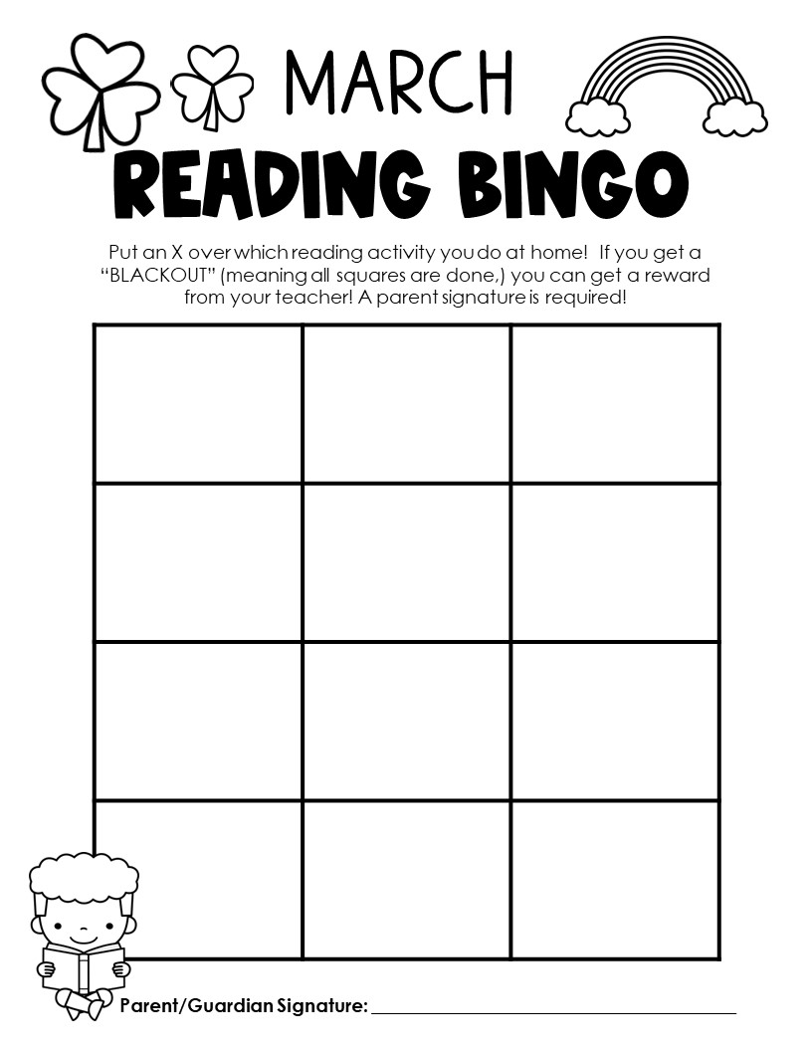
Read for 20 minutes
Read a fiction book
Read for 20 minutes
Read to a stuffed animal
Read a Dr. Seuss book
Read to a sibling or friend
Read a book in your favorite spot
Read a book on the weekend
Read out loud to an adult
Read for 20 minutes
Read a non-fiction book
Read for 20 minutes

Slide 9
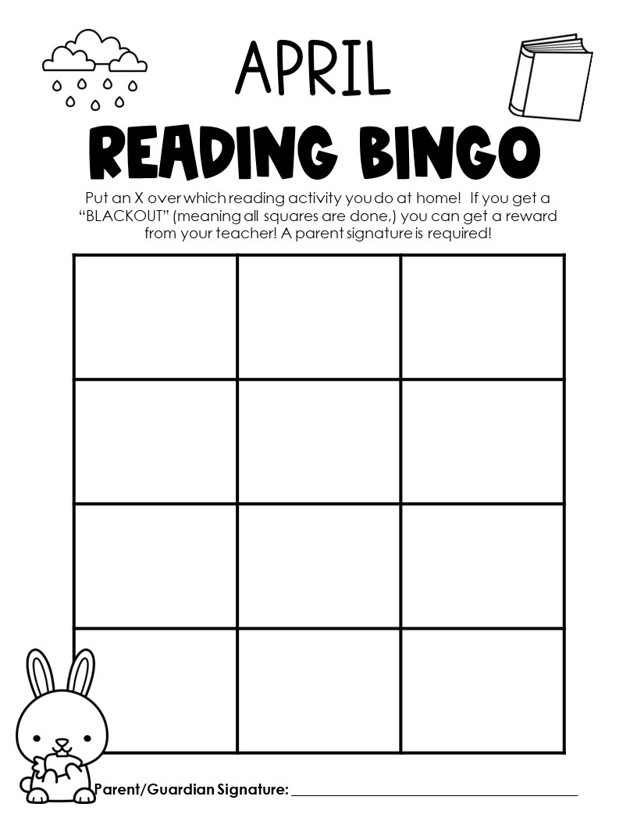
Read for 20 minutes
Read a fiction book
Read for 20 minutes
Read to a stuffed animal
Read outside
Read to a sibling or friend
Read a book in your favorite spot
Read a library book
Read out loud to an adult
Read for 20 minutes
Read a non-fiction book
Read for 20 minutes

Slide 10
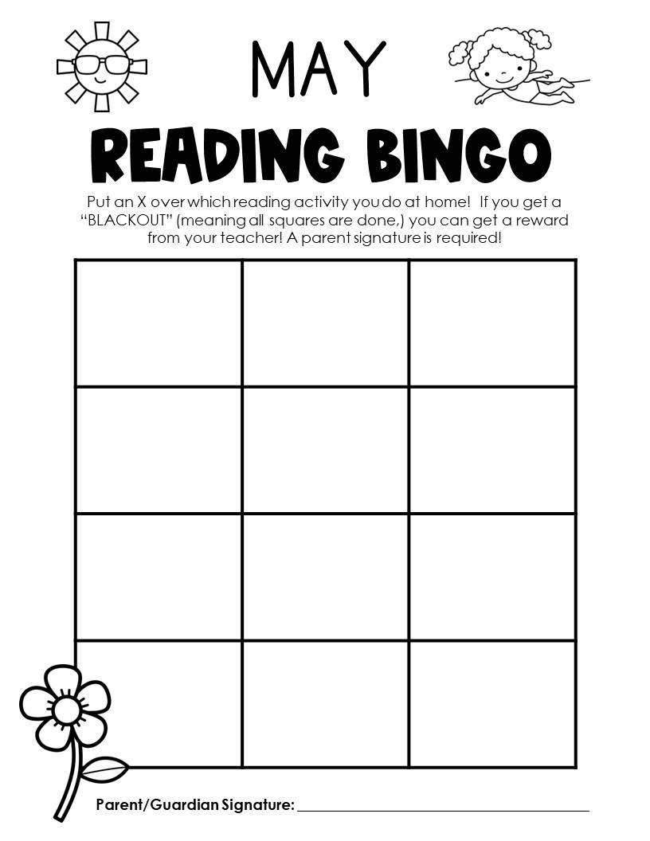
Read for 20 minutes
Read a fiction book
Read for 20 minutes
Read to a stuffed animal
Read a book that you LOVE
Read to a sibling or friend
Read a book in your favorite spot
Read a chapter book
Read out loud to an adult
Read for 20 minutes
Read a non-fiction book
Read for 20 minutes

